Slide 1
Online Test Management
Queries

Slide 2
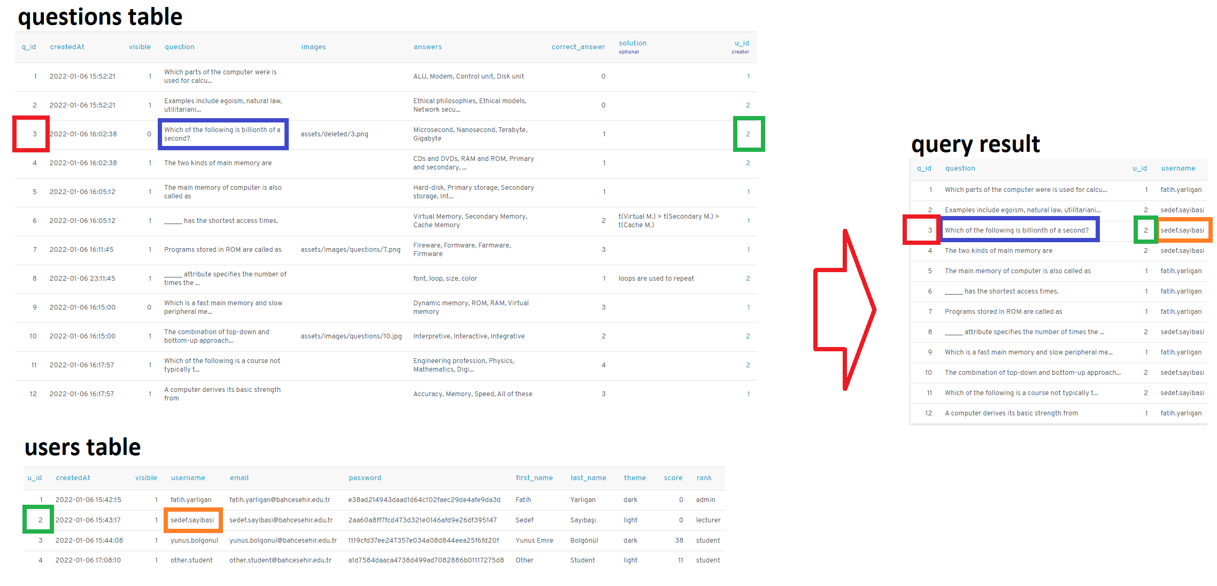
Join Queries 1
This query lists the id of the user and the question and which user created which question.

Slide 3
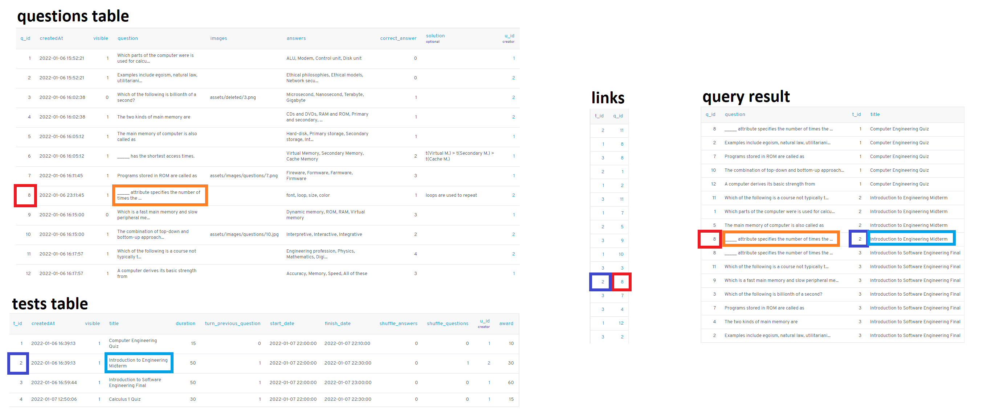
Join Queries 2
This query lists the id of the test and questions, and the title of the test its questions are linked to

Slide 4
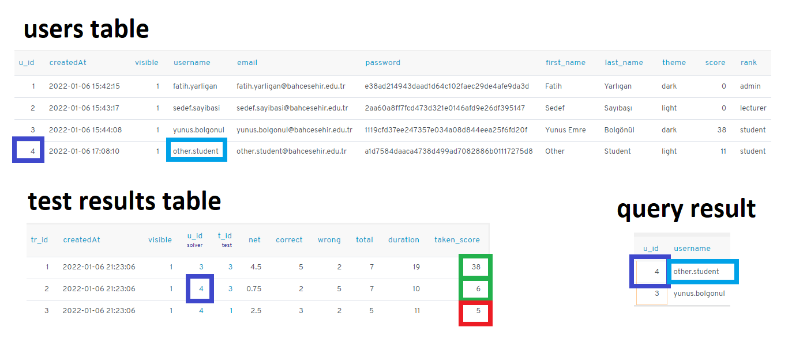
Nested Queries 1
This query lists the ids of the users who scored 6 or higher in the test result table.

Slide 5

Nested Queries 2
This query lists the users' ids and fullnames in order of highest net.

Slide 6
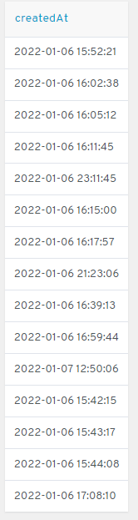
Set Operation Queries 1
This query lists the creation dates of all data

Slide 7
Set Operation Queries 2
This query lists all data of tests that have never been resolved.

Slide 8
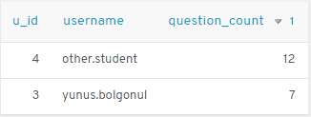
Aggregate Operations 1
This query lists the user's id, username, and number of questions solved in order from high to low.

Slide 9
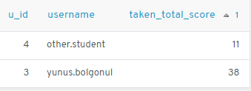
Aggregate Operations 2
This query ranks the user's ID, username, and sum of their test scores from low to high.

